Slide 1
Design: TAS Shared Tableau and Real Time Reporting Service
05/30/2018
v 0.1 DRAFT

Slide 2
Design: Reporting
Architecture
Design
Business Process
Application
Database
Technical

Slide 3
Architecture

Slide 4
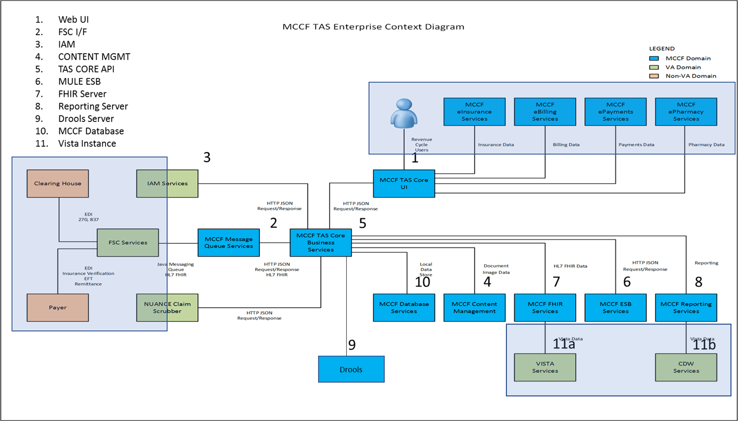
MCCF TAS Enterprise Context Diagram
This diagram shows the planned TAS components and their relationship to each other. The design in the following slides are specific to the ePharmacy Reporting release of TAS, and shows details for the Reporting Services being implemented as part of that release. Designs for other components are documented elsewhere.
TAS CORE UI
FSC Services
IAM Services
Content Mgmt.
Business Services
ESB Services
FHIR Services
Reporting Services
Rules Engine Services
Database Services
Vista Services
Components Used in this design

Slide 5
Design

Slide 6
Design: Assumptions, Constraints, Dependencies and Risks
Assumptions
An initial investigation and related findings are documented
Constraints, Dependencies and Risks
C - Must use a TRM approved product for use in the TAS platform. Our original implementation considered using a NO SQL database similar to Mongo but the TRM Has not approved use of any NO SQL databases at this time.
D - The reporting component is dependent on the use of the VistA Data Access Services implemented using the FHIR Server and the HTTP Listener/VistA Data Link;
R - If a mechanism used for accessing and retrieval of aggregated report data is not found then we will be unable to do reporting for the ePharmacy team in a timely manner.
M1 - Using CDW for storage and extraction (6 to 12 month window for missing files);
M2 - Using an internal store within the Business Layer (Microsoft Azure Storage) **** has been selected for use by development and is further defined in this presentation.
M3 - Using Tableau Server as the storage and extraction Mechanism which in turn would use Tableau file storage;

Slide 7
Business Process

Slide 8
Business Process Description
Reporting will be needed for all product lines.
ePharmacy product line needs a real time solution.
One of the epics in the TAS backlog is for porting reports from VistA to TAS.

Slide 9

Use Case
View Reports

Slide 10
Use Case Descriptions
View Reports in Reporting Frontend

Slide 11
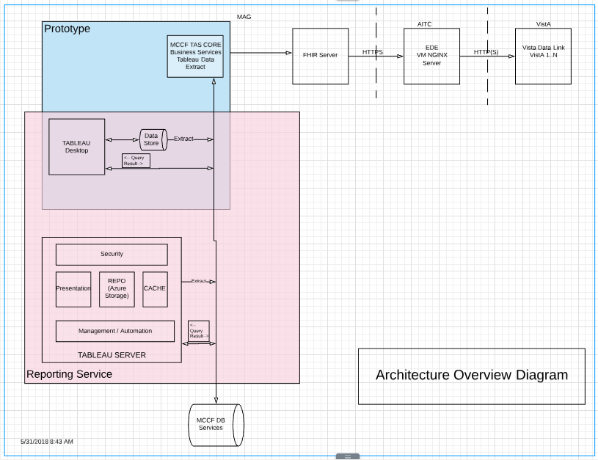

Slide 12
Architecture Overview Descriptions
Prototype
In order to provide the product team with access two mock FHIR servers and the Tableau Web Data Connector have been provided in order to gather and aggregate data. These can be used with the Tableau Desktop in order to work towards elaboration of user stories.
Tableau Desktop
A WYSIWYG desktop application used to deliver data from multiple sources and to create and define Visualizations including table based reports for use by the Tableau Server.
Tableau Server
Component selected to be used by TAS for serving reports created with the Desktop component.
Business Service
For Initial Prototyping with the Tableau desktop the Tableau Web Data Connector will be used. The Web Data Connector is an aggregator that will allow connections to the FHIR Server and return data back to the Tableau Desktop and Server.
For the future state the MCCF Database will be used to store and select data from.
FHIR Server
Resource server attached and providing data from the multiple VistA instances.
EDE Gateway from MAG
This will be a HTTP(S) instance of NGINX that will allow for traffic from the MAG to flow through AITC and the VistA instances.
Vista Data Instances
These are the 130+ instances of VistA that will be accessed to support data retrieval

Slide 13
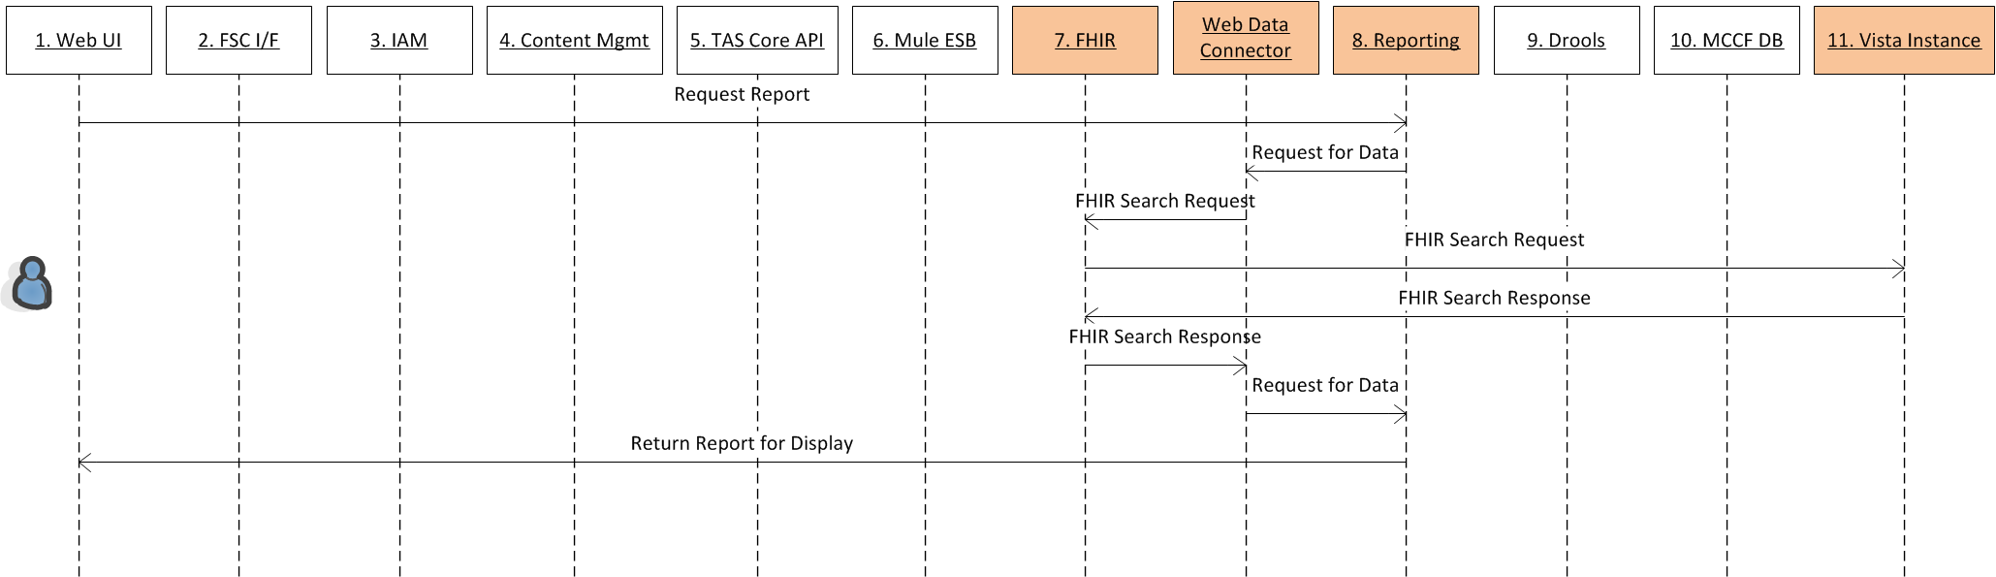
Sequence Diagram: Viewing Real Time
Components Used in this design

Slide 14
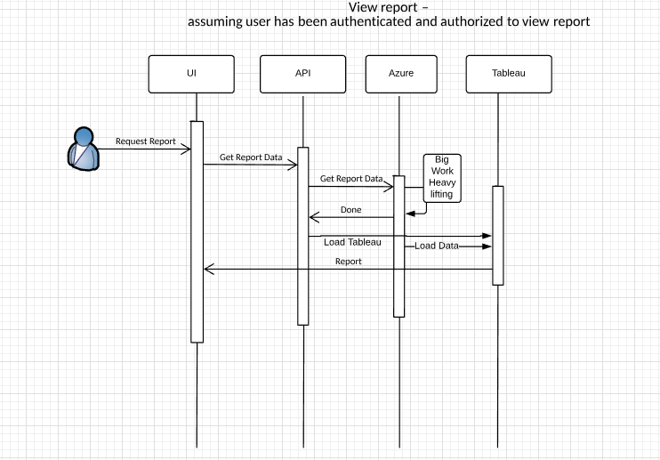
UML Realtime

Slide 15
Sequence Diagram: Viewing Description
Assuming the user has been authenticated and authorized to view the report, the Reporting Frontend will provide the user with a link to the report.
A JavaScript API component that provides the Tableau server API will be loaded and used to call and display reports in the TAS UI frontend. This API Script allows for Display of Visualizations; Dynamic Load and Resize, Filtering, Selecting Marks, Responding to Events and Exporting Visualizations to either Image or PDF Files
The Tableau Server will retrieve the data and the desired report (using the URL that was sent from the frontend).

Slide 16
Application

Slide 17
Custom Components
TAS Portal UI
Web Data Connector
Tableau Server Report
FHIR Server
Vista Link Updates
RPC Development

Slide 18
Component Definition
Name and Description:
Define the Test First:

Slide 19
Component Definition: Message Structure
Payload Type: Format (JSON), Structure, Elements, Attributes
All payload types from VistA will be in JSON format, the structure and format of the individual elements is based on the current fileman file structures. Additionally utility http functions were created that may not be available in production to facilitate data dictionary calls to retrieve information about the field and data structures. HTTP queries to VistA allow for the selection, creation, update and deletion of records and field data within VistA .
Define the Input (Message): What are the pre-conditions of the operation/service
TAS Core API service API interface HTTP Post Message that would start the extraction process.
Define configuration elements (Resource): Uses flexible lookup patterns, nothing is hardcoded, Uses a database table or a central configuration repository
TAS Core API service API interface NigthlyScriptExtract using Microsoft Azure Table (development purposes example);
http://server:port/api/v1/NightlyScriptExtract [get would provide a list of configuration options] http://server:port/api/v1/NightlyScriptExtract [get/:id return a single vista configuration option]
http://server:port/api/v1/NightlyScriptExtract [post would create a new configuration for a vista instance]
Aggregation defined configuration
This configuration will provide the needed aggregation hierarchy as JSON structures. This configuration will be used during the nightly process to write linkage information to the AZURE Storage .
Define the Output (Message): What are the post-conditions of the operation
Response will be defined by the individual API calls that are made. For instance the start action of the NightlyScriptExtract may be a mechanism used to kick off the call during development, while the pause may pause the current process and the stop would of course stop the process. The final API would be called by a configured CRON job using CURL to start the script.

Slide 20
Component Definition: Services
Define the transaction (Service): Pseudo code the Solution
Read all the vista configurations currently in the Microsoft Azure Table for the nightly extract.
Start the loop through the instances of Vista’s
Read the vista configuration information for a particular instance (e.g. 1, 40, 101)
Make a FHIR request for the IEN list of items by calling one of the resources available for instance http://<server:port>/ClaimResponse?location=001&lastUpdated=2017-04-17
Return the list of current IENs for the records to be used in the
Start the loop through the IEN’s
Make a FHIR request for the IEN list of items by calling one of the resources available for instance http://<server:port>/ClaimResponse?location=001&id=1
Return Response and Store to MAT with Location and ID as parameters to the MAT

Slide 21
Component Definition: Resources
Names and Descriptions: Definition and Setup; Interface Definitions; API’s, Libraries, Database Components; File Systems, Logs
FHIR Resource IEN Search
FHIR Resource Selection
TAS_Core_API logging
CRONTAB creation and CRON execution of CURL API Calls for jobs
Microsoft Azure Tables
Storage Account; Table; Entity
vista001 Instance, FHIR Resource (ClaimReponse), partitionkey, row, timestamp, ID, jsonstructure
Define the resources used during Transaction (Resource): Log output (be consistent), Error codes (be consistent), Interfaces, Database Tables
FHIR Server
Vista Server
TAS_CORE_API
Azure Storage Tables

Slide 22
Component Definition: Policy
Types of Policy – Security, Functional, Regulatory, Performance, Constraint Definition
Define policies and constraints (Policy): Regulatory, Business, Architecture

Slide 23
Datastore

Slide 24
Storage: TAS API
Schema, Object Combination, Duplication of Data, Joins, Optimize, Complex Aggregations
Data may initially be stored in Azure Storage as strings that are basically JSON Structures.
Azure Storage uses Azure Storage Tables to store data, and each table has 255 possible columns and 3 are used for the PartitionKey, RowKey and Timestamp.
Since the JSON data will be stored in the Azure Storage Tables we may be able to extract requested data on demand or on a scheduled frequency, any fields needed for direct access and then use a single column (64kb max size) for the actual JSON string.

Slide 25
Storage: TAS API
Azure storage

Slide 26
Technical

Slide 27
Technical
System, Network, Security & Administration

Slide 28
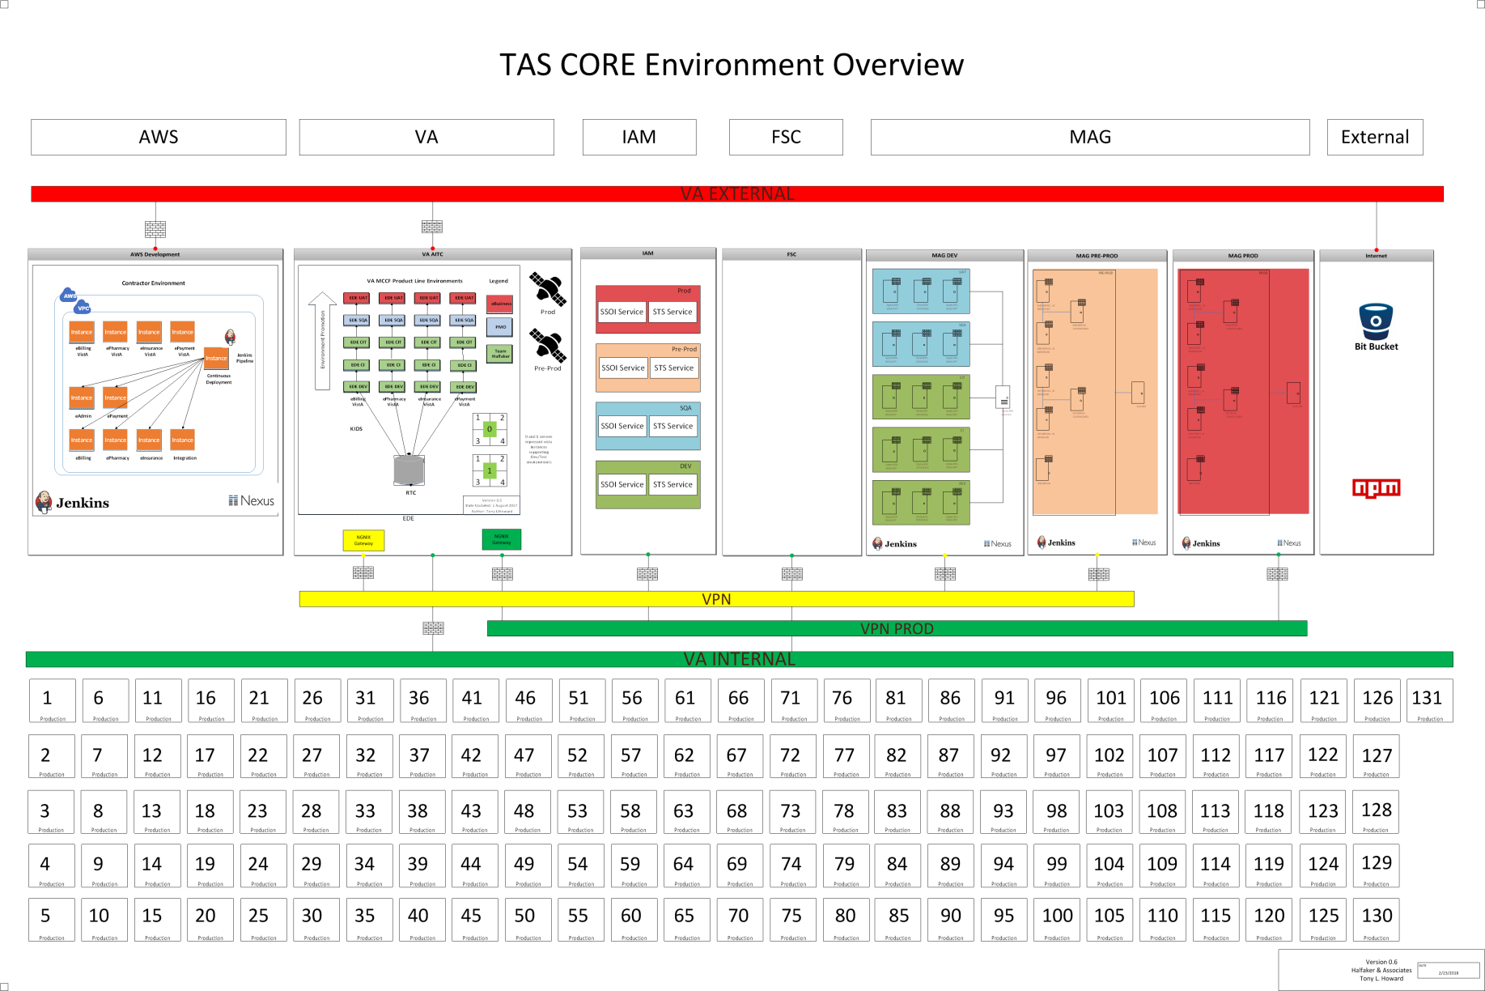
Technical: System

Slide 29
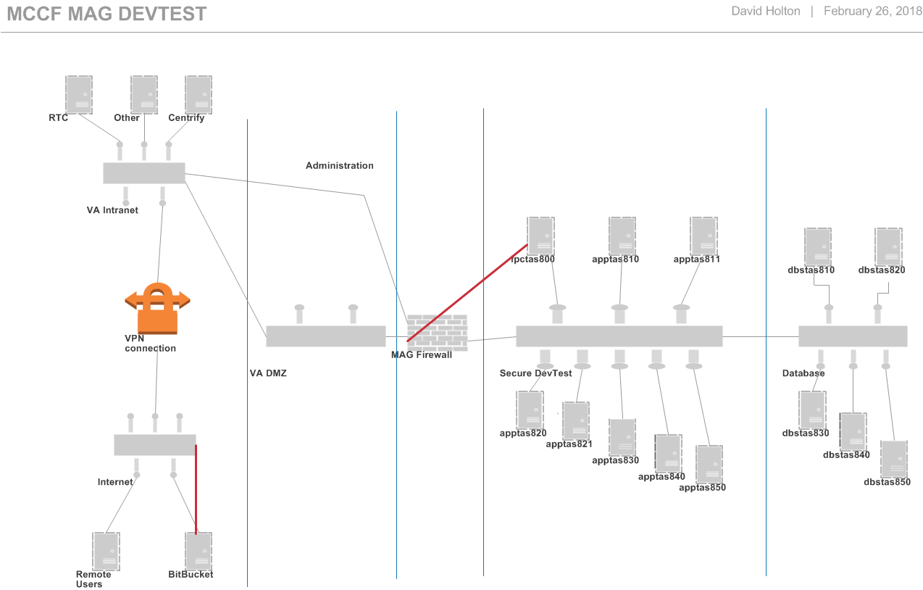
Technical: Network

Slide 30
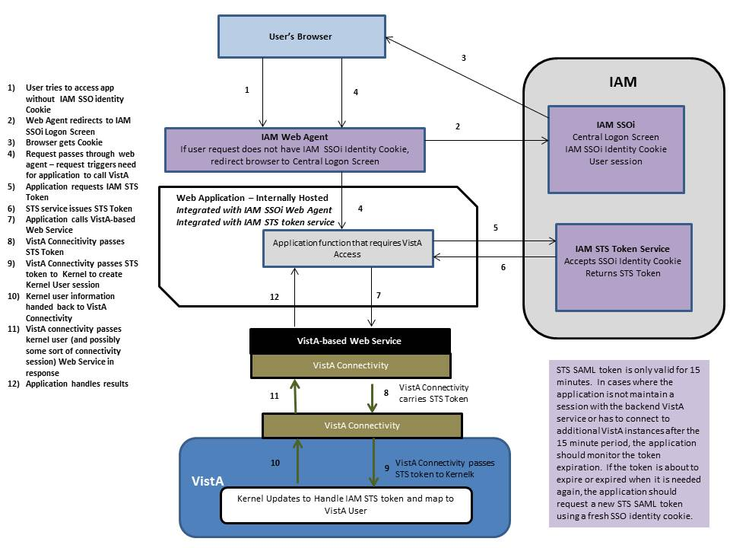
Technical: Security

Slide 31
Technical: Administration
We understand the need for, and have CM and Administration support of the current development systems and overall maintenance. A longer term strategy for the administrative sustainment of the Reporting Components still needs to be determined.

